Slide 1
Chapter 2a: Static Routing
Notes:
Cisco Networking Academy program
Routing Protocols
Chapter 6: Static Routing

Slide 2
Chapter 2a
Static Routing Implementation
Configure Static and Default IPv4 and IPv6 Routes
Configure Summary Static IPv4 Routes
Notes:
Chapter 6

Slide 3
Static Routing
Reach Remote Networks
A router can learn about remote networks in one of two ways:
Manually
  Remote networks are manually entered into the routing table of a router by the network administrator.
  These are called static routes.
Dynamically
  Remote routes are automatically learned between routers configured to communicate through a dynamic routing protocol.
Notes:
6.1.1.1 Reach Remote Networks

Slide 4
Static Routing
Static vs Dynamic Routing
Advantages of using static routing over dynamic routing:
More secure
  static routes are not advertised over the network.
No extra resources needed
  static routes use less bandwidth than dynamic routing protocols.
  no CPU cycles are used to calculate and communicate routes.
Predictable
  The path for that static route is always the same.
Notes:
6.1.1.2 Why Use Static Routing?

Slide 5
Static Routing
Static vs Dynamic Routing
Disadvantages of using static routing over dynamic routing:
Configuration Complexity
  Initial configuration and maintenance is time-consuming.
  Requires knowledge of the whole network for implementation.
Topology Changes
  Administrator intervention is required to maintain changing route information.
Suitable only for simple topologies
  Does not scale well with large networks as maintenance becomes difficult.
  Configuration can be error-prone, especially in large networks.
Notes:
6.1.1.2 Why Use Static Routing?

Slide 6
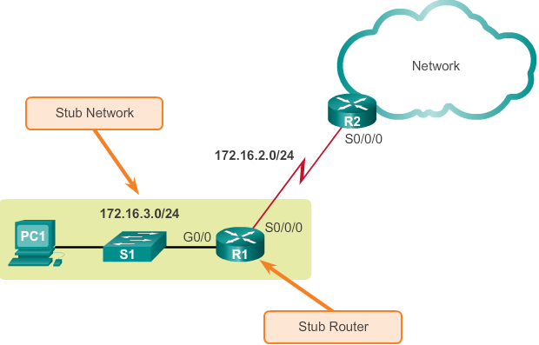
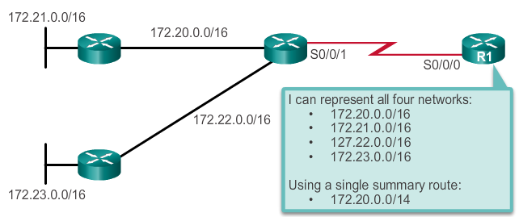
Types of Static Routes
Static Route Applications
Static Routes are often used to:
Provide a Gateway of Last Resort (default static route) for a stub network
Route to a specific network.
Reduce the number of routes advertised by summarizing several contiguous networks as one static route.
Create a backup route in case a primary route link fails.
Notes:
6.1.2.1 Static Route Applications

Slide 7
Configure IPv4 Static Routes
Command: ip route
To configure a static route:
R1(config)#ip route network mask {next-hop-ip | exit-int}
Network: destination network address to be added
Mask: subnet mask of the destination network
Either
next-hop-ip: the IP address of the neighbour router interface to send the packet
OR
exit-int: the local interface id of this router to send the packet
Example:
# ip route 10.20.30.0 255.255.255.0 192.168.1.2
# ip route 10.20.30.0 255.255.255.0 S0/0/0
Notes:
6.2.1.1 ip route Command

Slide 8
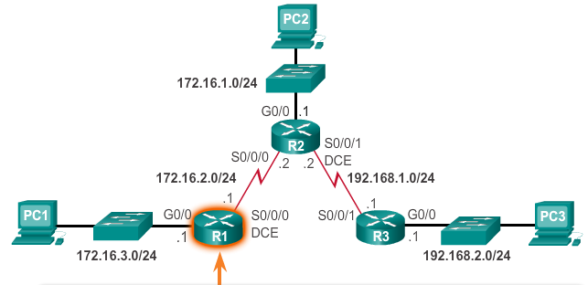
Configure IPv4 Static Routes
Configure a Network Static Route
For router R1 to know how to forward packets to PC2 and PC3, the remote networks need to be added:-
R1(config)# ip route 172.16.1.0 255.255.255.0 S0/0/0
R1(config)# ip route 192.168.1.0 255.255.255.0 S0/0/0
R1(config)# ip route 192.168.2.0 255.255.255.0 172.16.2.2
Similar configuration has to be done on routers R2 and R3 in order for all the PCs to communicate
Notes:
6.2.1.3 Configure a Next-Hop Static Route

Slide 9
Configure IPv4 Static Routes
Configure a Default Static Route
A default static route:-
is a route that matches all packets.
identifies the gateway IP address for packets that has no match in the routing table.
is simply a static route with 0.0.0.0/0 as the destination address.
To configure a default static route:
R1(config)#ip route 0.0.0.0 0.0.0.0 {next-hop-ip | exit-int}
Notes:
6.1.2.3 Default Static Route

Slide 10
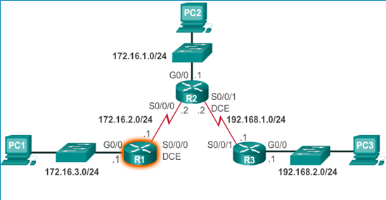
Configure IPv4 Default Routes
Configure a Default Static Route
Using router R3 as example.
Configuring router R3 with a default static route to route all unknown packets through the S0/0/1 exit interface as shown:-
R3(config)# ip route 0.0.0.0 0.0.0.0 S0/0/1
Notes:
6.2.2.2 Configure a Default Static Route

Slide 11
Configure IPv4 Static Routes
Verify a Static Route (running-config)
Check the configured static routes in the running-config file using #show running-config
The static route entries will be shown in the file
R1# show run
<-- output omitted -->
interface Vlan1
no ip address
shutdown
!
ip classless
ip route 172.16.1.0 255.255.255.0 Serial0/0/0
ip route 192.168.1.0 255.255.255.0 Serial0/0/0
ip route 192.168.2.0 255.255.255.0 172.16.2.2
!
ip flow-export version 9
<-- output omitted -->
Question:
How do you remove a wrong static route?
Notes:
6.2.1.6 Verify a Static Route

Slide 12
Configure IPv4 Static Routes
Verify a Static Route (routing table)
Check the routing table using #show ip route
The static route entries are marked with the route source code “S”.
R1#show ip route
<-- output omitted -->
Gateway of last resort is not set
172.16.0.0/16 is variably subnetted, 5 subnets, 2 masks
S 172.16.1.0/24 is directly connected, Serial0/0/0
C 172.16.2.0/24 is directly connected, Serial0/0/0
L 172.16.2.1/32 is directly connected, Serial0/0/0
C 172.16.3.0/24 is directly connected, GigabitEthernet0/0
L 172.16.3.1/32 is directly connected, GigabitEthernet0/0
S 192.168.1.0/24 is directly connected, Serial0/0/0
S 192.168.2.0/24 [1/0] via 172.16.2.2
Using exit interface
Using next-hop IP
Notes:
6.2.1.6 Verify a Static Route

Slide 13
Configure IPv4 Static Routes
Verify a Static Route (routing table)
A default static route entry is marked “S*”.
R1#show ip route
<-- output omitted -->
Gateway of last resort is 0.0.0.0 to network 0.0.0.0
192.168.1.0/24 is variably subnetted, 2 subnets, 2 masks
C 192.168.1.0/24 is directly connected, Serial0/0/1
L 192.168.1.1/32 is directly connected, Serial0/0/1
192.168.2.0/24 is variably subnetted, 2 subnets, 2 masks
C 192.168.2.0/24 is directly connected, GigabitEthernet0/0
L 192.168.2.1/32 is directly connected, GigabitEthernet0/0
S* 0.0.0.0/0 is directly connected, Serial0/0/1
Notes:
6.2.1.6 Verify a Static Route

Slide 14

Configure IPv6 Static Routes
The ipv6 route Command
For IPv6 networks, most parameters are identical to the IPv4 version of the command:-
Examples:-
#ipv6 route 2001:db8:acad:3::/64 s0/0/0
#ipv6 route 2001:db8:acad:5::/64 2001:db8:acad:5::2
Notes:
6.2.3.1 The ipv6 route Command

Slide 15
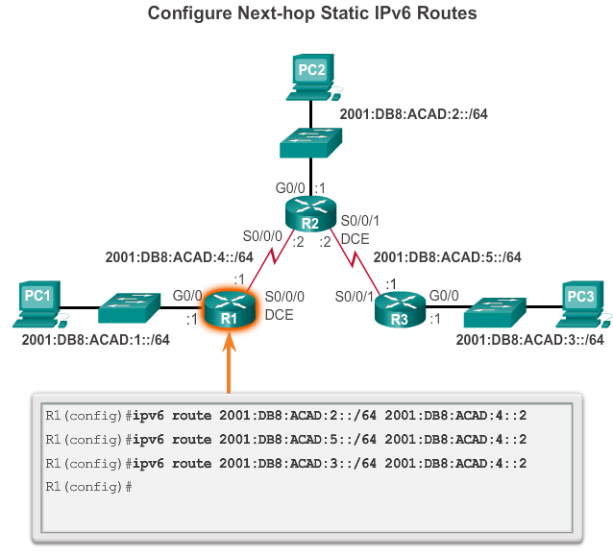
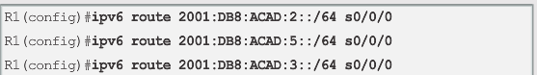
Configure IPv6 Static Routes
Configure a Static IPv6 Route
OR
Notes:
6.2.3.3 Configure a Next-Hop Static IPv6 Route

Slide 16
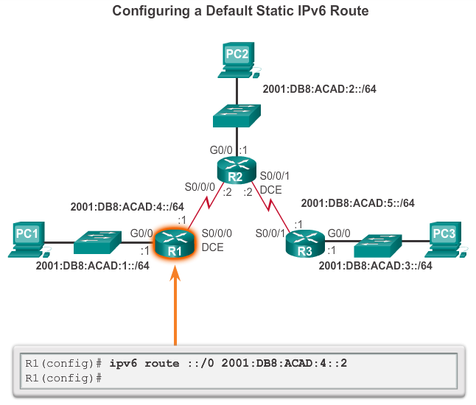
Configure IPv6 Default Routes
Configure a Default Static IPv6 Route
Notes:
6.2.4.2 Configure a Default Static IPv6 Route

Slide 17
Configure IPv6 Static Routes
Verify IPv6 Static Routes
Verify IPv6 static routes using:
# show running-config
# show ipv6 route
Notes:
6.2.3.6 Verify IPv6 Static Routes

Slide 18
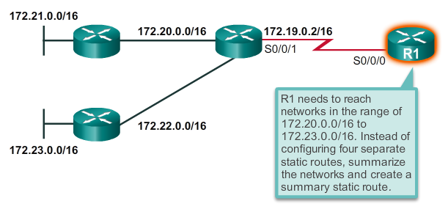
Configure IPv4 Summary Routes
CIDR and Route Summarization
Notes
There are 4 remote networks that R1 needs to reach.
To do so using static routes, R1 can have these 4 static routes inserted into its routing table (172.21.0.0/16 to 172.23.0.0/16)
Note that these 4 static routes use the same exit interface or next-hop IP address.
Question
Is there a better way other than to insert these 4 static routes?
Calculate 1 summary static route that can summarise these 4 static routes and insert this summary static route instead.
Notes:
6.3.2.2 CIDR and Route Summarization

Slide 19
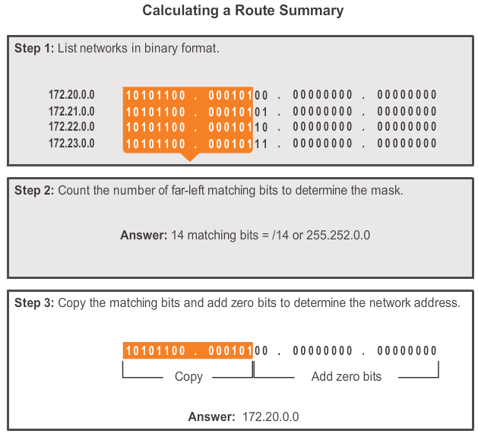
Configure IPv4 Summary Routes
Calculate a Summary Route
Notes:
6.4.1.2 Calculate a Summary Route

Slide 20
Configure IPv4 Summary Routes
Summary Static Route Example
R1(config)#ip route 172.20.0.0 255.252.0.0 s0/0/0
OR using next-hop IP address
R1(config)#ip route 172.20.0.0 255.252.0.0 172.19.0.2
Note that if the 4 static routes have been pre-configured already, they must be removed in order for the summary route to take effect.
Notes:
6.4.1.3 Summary Static Route Example

